Slide 1
GREENSAT
Providing CO2 emission Solutions.

Slide 2
ABOUT US
A pioneering company specializing in captivating timelapses of various locations. With a passion for environmental responsibility, we go beyond visuals, providing valuable carbon dioxide emission data. Our innovative approach combines stunning imagery with critical environmental insights, promoting awareness and sustainability in an engaging way.

Slide 3
KEY FEATURES
Geo-Satelite Timelapse creator to monitor devlopment.
Interactive Graphs for rise in carbon dioxide levels using open source data.

Slide 4
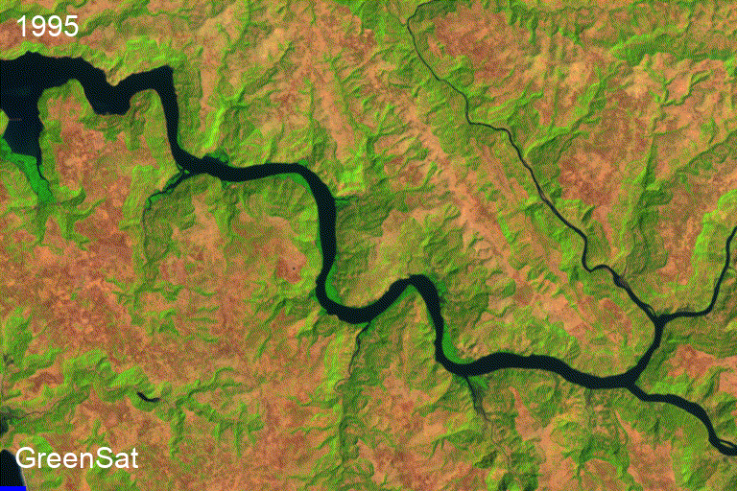
Timelapse creator

Slide 5
Interactive Carbon DIOXIDE Time series

Slide 6
DEPENDENCIES
EARTH ENGINE / GEEMAP
PLOTY
PYTHON API AND INTERACTIVE MAPS
INTERACTIVE AND EASY TO UNDERSTAND GRAPHS
CSV
IPYWIDGETS/IPYTHON.DISPLAY
READ AND CODE WITH .CSV FILES FOR DATABASES
INTERACTIVE UI AND WIDGETS

Slide 7
CODE OVERVIEW
UI
JUPYTER NOTEBOOK AND IPYWIDGETS PROVIDES A SIMPLE SOLUTION TO DISPLAY INTERACTIVE WIDGETS.
TIMELAPSE GENERATOR
USING GEEMAP TOOLS TO CREATE TIMELAPSES FOR A SELECTED AREA.
CARBON DIOXIDE TRACKING
USING OPEN-SOURCE .CSV DATABASES AND FILTERING THEM TO GIVE AN OUTPUT
PREDICTION
USING DATA REGRESSION MODELS TO PREDICT FUTURE DATA

Slide 8



Meet the team
Shreyan das
Jaswanth reddy
Prakhar t.

Slide 9
ACTION PLAN
RUN TESTING USING LOCAL HOSTS
GATHER FEEDBACK
DELIVER TO THE PUBLIC
2024
JAN
FEB
MAR
APR
MAY
JUN
JUL
AUG
SEP
OCT
NOV
DEC
2024
JAN
FEB
MAR
APR
MAY
JUN
JUL
AUG
SEP
OCT
NOV
DEC
FURNISH THE PROJECT
TEST DESIGN AND USE CASES
LAUNCH DESIGN

Slide 10
THANK YOU
GreenSat
+91 8105299140
Greensat.co@gmail.com

